Slide 1
Enabling 21st Century classrooms
V Vandhana Veerni – CIO

Slide 2
Taskforce Feedback
In short we need to identify and act upon the following for success:
Why?
Who?
What?
When?
How?

Slide 3
Why?
Our students are digital natives and need platforms of the future.
Creates a blended classroom of digital and traditional learning.
Increases student engagement, achievement.
Increases communication and collaboration.
Taps student creativity.
Students can produce a variety of work that demonstrates
understanding and their preparedness for the future.

Slide 4
Who?
Our students
Our schools based Instructional Staff
Our non-schools based Staff

Slide 5
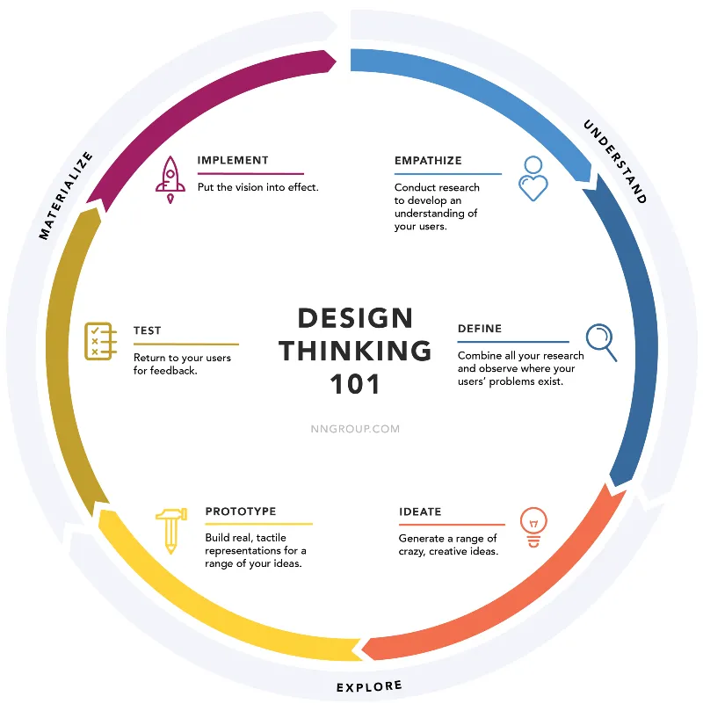
What?

Slide 6
Taskforce Sub-committees
Inspiration AKA Understand Phase
Empathize
User Engagement subcommittee
1. Community, Parents, Students, 2. Teachers, other staff desirability
3. Focus on Says, Does, Feels, Thinks
4. What additional skills do our students need with technology?
5. Integration with Portrait of a Graduate
Define
Define the classroom of the 21st Century subcommittee
1. What comes to mind when you hear this phrase?
2. Complete components of a classroom – not just devices
3. Blended Learning components
4. Equity and Inclusion – ESL, IEP, Gifted
5. Safety and Security
6. Integration with Academic Services MTSS

Slide 7
Taskforce Sub-committees
Ideation aka Explore Phase
Ideate
Technology subcommittee
1. Map to User Engagement Sub-committee and Define Sub-Committee
2. Vendor Engagement – device vendors, Tierney Brothers
3. Identify the device of the 21st century classroom
4. Identify the other infrastructure components – power in classrooms, access points, power chords, keyboards, mouse, right tool to impart a complete technology curriculum, smartboards, access points, device management software, imaging for these devices, permissions, how to manage patches, end point security, CFIS filtering. Parent Education, Student Education, Frontline support, Frontline support education
5. Access to Internet – in schools, outside of schools
6. Replacement of technology – lifecycle, lost, stolen, damaged
7. Repair and Support of technology – on-going, mfr warranties etc

Slide 8
Taskforce Sub-committees
Ideation aka Explore Phase Continued…
Ideate
Professional Development subcommittee
1. Identify pedagogy
2. Identify all technology components – devices, learning management tools, instructional delivery methods, supports in the classroom
3. Vendor Engagement – Professional development vendors, internal supports for PD
4. Delivery of PD – potential schedules, order of delivery
5. Organizational Change Management – what else is changing?

Slide 9
Taskforce Sub-committees
Ideation aka Explore Phase
Prototype
HR subcommittee
1. Map to Other ideate sub-committees
2. Unions and Associations Engagement to prototype
3. Resource Identification and management
4. Identify the other HR components
Communication subcommittee
1. How do we communicate this to all stakeholders
2. When and how?
Prototype Testing subcommittee
1. Identify early adopters – the new Dominion school perhaps?
2. Identify other infrastructure required to test prototype
3. Conduct prototype testing of MAP (minimally awesome product)

Slide 10
Taskforce Sub-committees
Implementation AKA Materialize Phase
Test
User Engagement subcommittee
1. Identify the pilot users
2. Rigorously test with them – champion for stakeholders
3. Bring back results to other sub-committees to improve the delivery
Implement
Delivery subcommittee – plan now, execute later – 3 yrs
1. Identify implementation plan in phases and dates
2. Implement the plan
3. Identify future phases and dates

Slide 11
Teamwork makes the dream work!
There is no “I” in Team!

